Slide 1
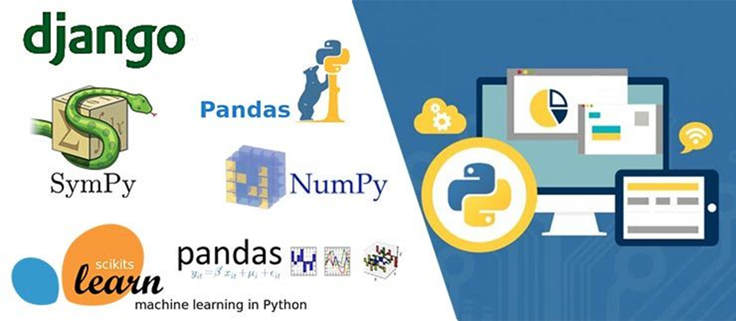
Introduction Python
Python Basics

Slide 2
Agenda
What is python
What can python do
Python ranking
Why learn Python?
IEEE Spectrum 2016-2017 rankings
14 best programming languages
Basics of Python programming
Python GUI development with Tkinter

Slide 3
What is Python?
Python is an open source, object-oriented, high-level powerful programming language.
Developed by Guido van Rossum in the early 1990s. Named after Monty Python
Python runs on many Unix variants, on the Mac, and on Windows 2000 and later.

Slide 4
What can Python do?
System utilities (system admin tools, command line programs)
Web Development
Graphical User Interfaces (Tkinter, gtk, Qt).
Internet scripting
Embedded scripting
Database access and programming
Game programming
Rapid prototyping and development
Distributed programming

Slide 5
Features of Python
Open source
Easy-to-learn
High-level Language: Python is an example of a high-level language like C, C++, Perl, and Java with low-level optimization
Portable
Object-Oriented: Python is a full-featured object-oriented programming language, with features such as classes, inheritance, objects, and overloading
Python is Interactive
Interpreted: Python programs are interpreted, takes source code as input, and then compiles (to portable byte-code) each statement and executes it immediately
Extendable: The Python interpreter is easily extended and can add a new built-in function or modules written in C/C++/Java code
Libraries
Supports

Slide 6

Organizations using python
It is a very popular language in multiple domains like Automation, Big Data, AI etc. You will also be impressed as it used by the vast multitude of companies around the globe.

Slide 7
Organizations Using Python (sector wise)
Web Development : Yahoo Maps, Yahoo Groups, Google, Zope Corporation, Ultraseek, Linux Weekly News, ElasticHosts Cloud Servers, Mojam.com, hunch, Shopzilla, Movieplayer.it, Multiplayer.it.
Games: Battlefield 2, Crystal Space, Star Trek Bridge Commander, The Temple of Elemental Evil, Vampire: The Masquerade: Bloodlines, Civilization 4, QuArK (Quake Army Knife)
Graphics : Industrial Light & Magic, Walt Disney Feature Animation, HKS, Inc. (ABAQUS/CAE), RoboFog, Caligari Corporation, Blender 3D, Jasc Software, Paint Shop Pro.
Notes:
The modern view of neural networks began in the 1940s with the work of Warren McCulloch and Walter Pitts [McPi43], who showed that network of artificial neurons could, in principle, compute any arithmetic or logical function. Their work is often acknowledged as the origin of the neural network field.
McCulloch and Pitts were followed by Donald Hebb [Hebb49], who proposed that classical conditioning (as discovered by Pavlov) is present because of the properties of individual neurons. He proposed a mechanism for learning in biological neurons.
The first practical application of artificial neural networks came in the late 1950s, with the invention of the perceptron network and associated learning rule by Frank Rosenblatt [Rose58]. Rosenblatt and his colleagues built a perceptron network and demonstrated its ability to perform pattern recognition.
This early success generated a great deal of interest in neural network research. Unfortunately, it was later shown that the basic perceptron network could solve only a limited class of problems.

Slide 8
Organizations Using Python (sector wise)
Financial : Altis Investment Management, ABN AMRO Bank, Treasury Systems, Bellco Credit Union, Journyx Timesheet and Resource Management Software
Science : National Weather Service, Radar Remote Sensing Group, Applied Maths, Biosoft, The National Research Council of Canada, Los Alamos National Laboratory (LANL) Theoretical Physics Division, AlphaGene, Inc., LLNL, NASA, Swedish Meteorological and Hydrological Institute (SMHI), Environmental Systems Research Institute (ESRI), Objexx Engineering, Nmag Computational Micromagnetics

Slide 9
Organizations Using Python (sector wise)
Electronic Design Automation: Ciranova, Productivity Design Tools, Object Domain, Pardus, Red Hat, SGI, Inc., MCI Worldcom, Nokia,
Education : University of California, Irvine, Smeal College of Business, The Pennsylvania State University, New Zealand Digital Library, IT Certification Exam preparation, SchoolTool,
Business Software : Raven Bear Systems Corporation, Thawte Consulting, Advanced Management Solutions Inc., IBM, Arakn<E9>, RealNetworks, dSPACE, Escom, The Tiny Company, Nexedi, Piensa Technologies - Bufete Consultor de Mexico, Nektra, WuBook.

Slide 10
Organizations Using Python (sector wise)
Electronic Design Automation: Ciranova, Productivity Design Tools, Object Domain, Pardus, Red Hat, SGI, Inc., MCI Worldcom, Nokia,
Education : University of California, Irvine, Smeal College of Business, The Pennsylvania State University, New Zealand Digital Library, IT Certification Exam preparation, SchoolTool,
Business Software : Raven Bear Systems Corporation, Thawte Consulting, Advanced Management Solutions Inc., IBM, Arakn<E9>, RealNetworks, dSPACE, Escom, The Tiny Company, Nexedi, Piensa Technologies - Bufete Consultor de Mexico, Nektra, WuBook.

Slide 11
Python Syntax compared to other programming languages
Python was designed to for readability and has some similarities to the English language with influence from mathematics.
Python uses new lines to complete a command, as opposed to other programming languages which often use semicolons or parentheses.
Python relies on indentation, using whitespace, to define scope; such as the scope of loops, functions and classes. Other programming languages often use curly-brackets for this purpose.

Slide 12
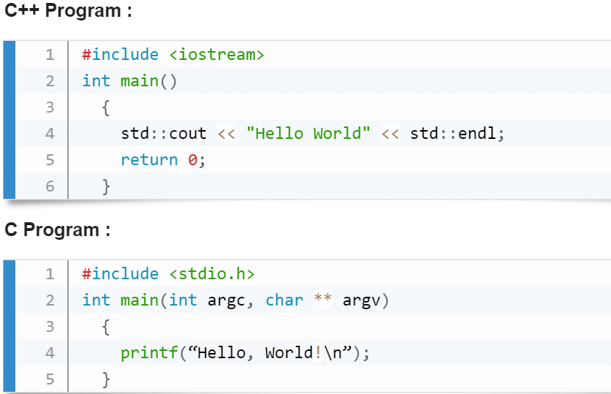
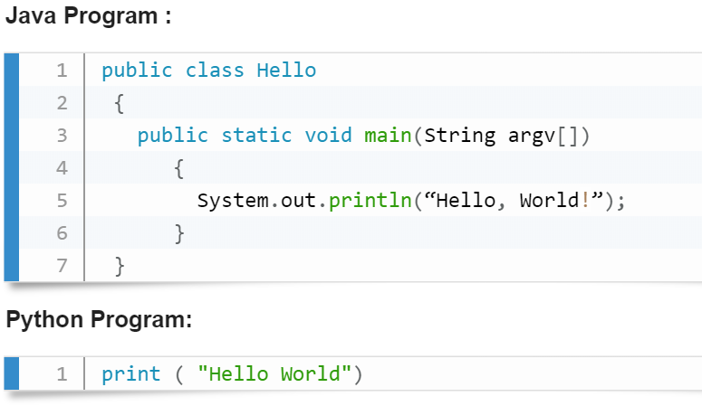
Python Syntax compared to other programming languages

Slide 13
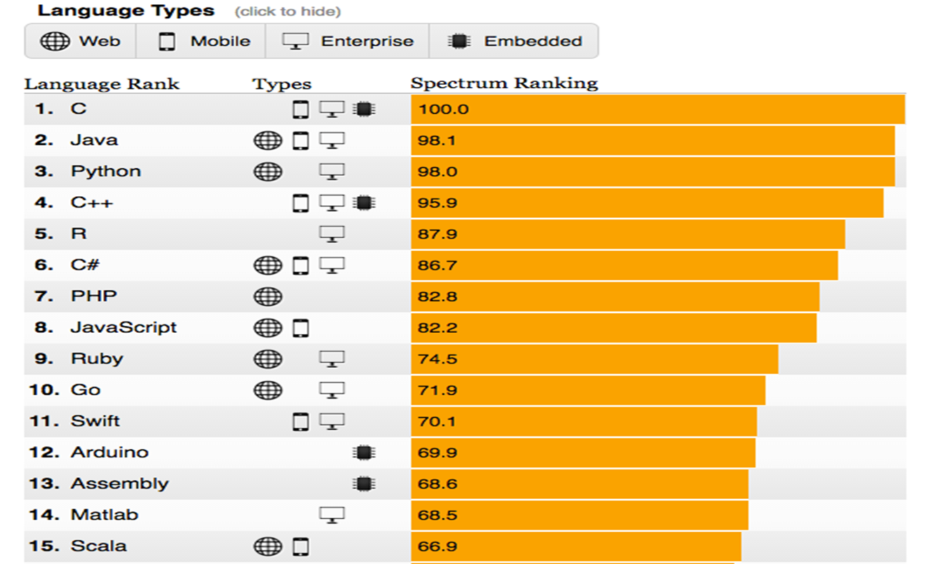
IEEE Spectrum 2016 ranking

Slide 14
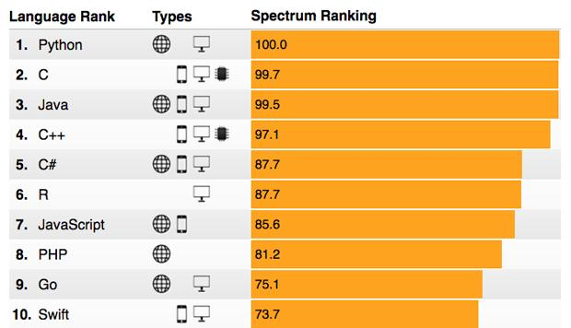
IEEE Spectrum 2017 ranking

Slide 15
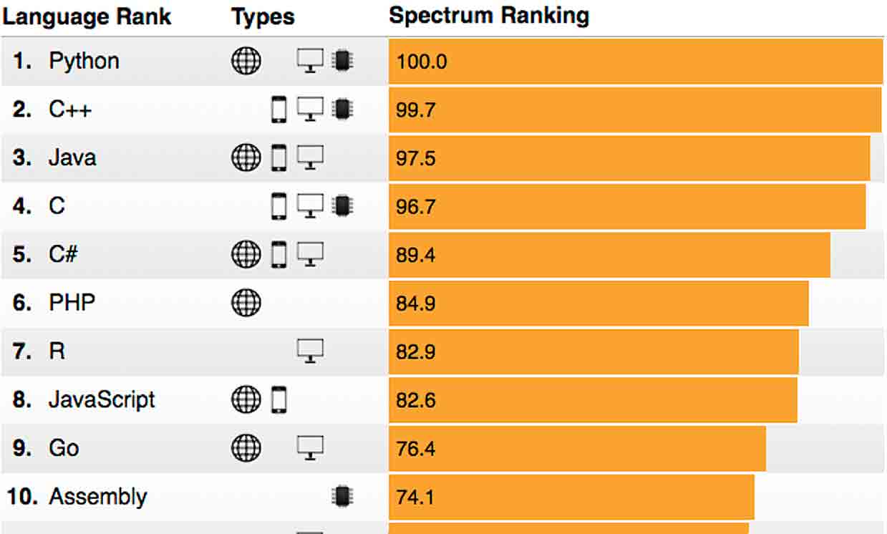
The 2018 Top Programming Languages

Slide 16
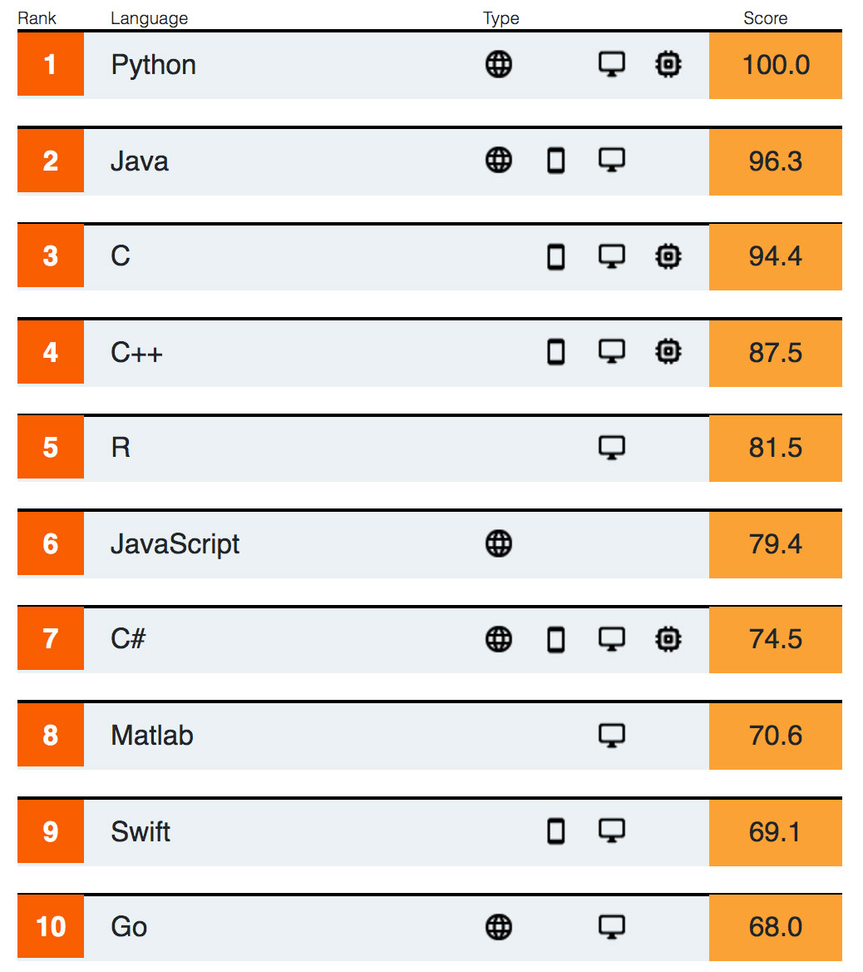
The 2019 Top Programming Languages

Slide 17
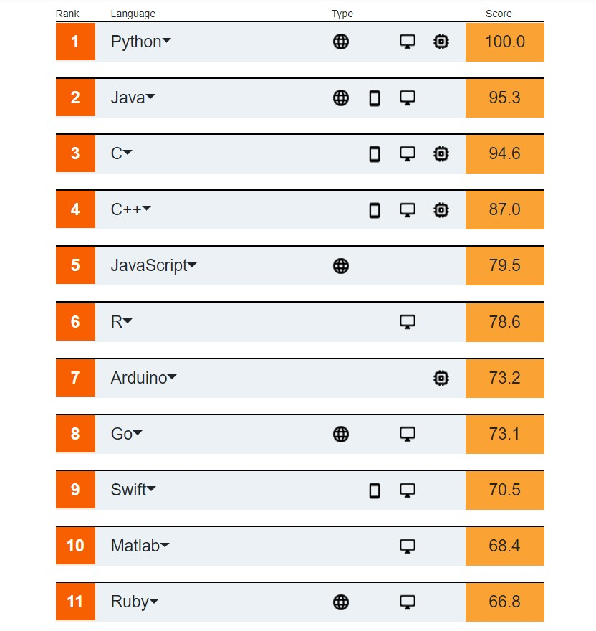
The 2020 Top Programming Languages

Slide 18
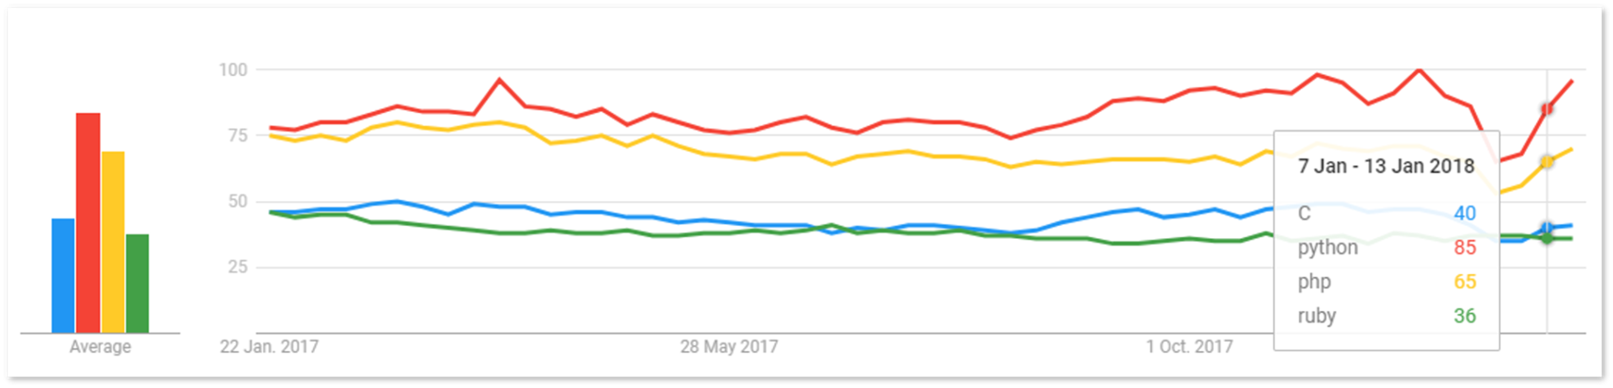
Salary Package
The average Python Developer salary in the United States is approximately $116,028 per year.
Also, Python has a strong spike in popularity over the last 1year. Refer the below screenshot taken from Google Trends.

Slide 19
Python 2.x VS Python 3.x
Syntax | Python 2 | Python 3
print statement vs. print function | print "Hello World" | print("Hello World")
range and xrange | range(1, 10) [1, 2, 3, 4, 5, 6, 7, 8, 9] | range(1, 10) range(1, 10) no xrange
Raising and handling Exceptions | [3, 5] > 'xyz’ False | list() > str()
Comparison of unorderable types | print "[2, 3]>'xyz'= ", [2, 3]>'xyz' [2, 3]>'xyz' = False | list() > str()
bytes vs string | >>> a = "Python" >>> len(a) | To treat a string as a sequence of bytes, you need to cast: >>> a = bytes("Python", "utf-8")
Integer division | >>> print "6//3 =", 6//3 6//3 = 2 | >>> print("6/3 =", 6/3) 6/3 = 2.0
dictionary method | dict.iteritems(): Return an iterator over the dictionary's (key, value) pairs | dict.items(): Return a copy of the dictionary’s list of (key, value) pairs.
Data Input | >>>data_input2 = raw_input() | >>>data_input3 = input()

Slide 20
Python Coding Style:
Use 4 spaces per indentation and no tabs.
Do not mix tabs and spaces. Tabs create confusion and it is recommended to use only spaces.
Maximum line length : 79 characters which help users with a small display.
Use blank lines to separate top-level function and class definitions and single blank line to separate methods definitions inside a class and larger blocks of code inside functions.
When possible, put inline comments (should be complete sentences).
Use spaces around expressions and statements.
Notes:
The brain consists of a large number (approximately 10^ 11 ) of highly connected elements (approximately 10^4 connections per element) called neurons.
For our purposes these neurons have three principal components:
The dendrites:
The dendrites are tree-like receptive networks of nerve fibers that carry electrical signals into the cell body.
The cell body:
The cell body effectively sums and thresholds these incoming signals.
The axon:
The axon is a single long fiber that carries the signal from the cell body out to other neurons.
The point of contact between an axon of one cell and a dendrite of another cell is called a synapse. It is the arrangement of neurons and the strengths of the individual synapses, determined by a complex chemical process, that establishes the function of the neural network.

Slide 21
Python Reserve words:
False | class | finally | is | return
None | continue | for | lambda | try
True | def | from | nonlocal | while
and | del | global | not | with
as | el | if | or | yield
assert | else | import | pass
break | except | in | raise

Slide 22
Variable and Value
A variable is a memory location where a programmer can store a value. Example : roll_no, amount, name etc.
Value is either string, numeric etc. Example : "Sara", 120, 25.36
Variables are created when first assigned.
Variables must be assigned before being referenced.
The value stored in a variable can be accessed or updated later.
No declaration required
The type (string, int, float etc.) of the variable is determined by Python
The interpreter allocates memory on the basis of the data type of a variable.

Slide 23
Python Variable Name Rules
Must begin with a letter (a - z, A - B) or underscore (_)
Other characters can be letters, numbers or _
Case Sensitive
Can be any (reasonable) length
There are some reserved words which you cannot use as a variable name because Python uses them for other things.

Slide 24
Good Variable Name
Choose meaningful name instead of short name. roll_no is better than rn.
Maintain the length of a variable name. Roll_no_of_a-student is too long?
Be consistent; roll_no or RollNo
Begin a variable name with an underscore(_) character for a special case

Slide 25
Python Assignment Statements
The assignment statement creates new variables and gives them values. Basic assignment statement in Python is :
Item_name = "Computer" #A String
Item_qty = 10 #An Integer
Item_value = 1000.23 #A floating point
print (Item_name)
print (Item_qty)
print (Item_value)

Slide 26
Local and global variables in Python
Variables that are only referenced inside a function are implicitly global. If a variable is assigned a value anywhere within the function’s body, it’s assumed to be a local unless explicitly declared as global.
var1 = "Python"
def func1():
var1 = "PHP"
print("In side func1() var1 = ",var1)
def func2():
print("In side func2() var1 = ",var1)
func1()
func2()

Slide 27
Local and global variables in Python
We can use a global variable in other functions by declaring it as global keyword :
def func1():
global var1
var1 = "Python"
print("In side func1() var1 = ",var1)
def func2():
print("In side func2() var1 = ",var1)
func1()
func2()

Slide 28
Python Data Type
Type represents the kind of value and determines how the value can be used
All data values in Python are encapsulated in relevant object classes, Everything in Python is an object and every object has an identity, a type, and a value
Python has three distinct numeric types: integers, floating point numbers, and complex numbers, Booleans are a subtype of plain integers.
x = 212
y = 12.6
z = complex(1,2)
name = ("Hello World")
var_bol= True
print (type(x))
print (type(y))
print (type(z))
print (type(name))
print(type(var_bol))

Slide 29
Strings
In Python, a string type object is a sequence (left-to- right order) of characters. Strings start and end with single or double quotes Python strings are immutable
mystr = "Python String"
mystr1 = "Second String"
print (mystr)
print (mystr1)
print(type(mystr))
print(type(mystr1))

Slide 30
Special characters in strings
The backslash (\) character is used to introduce a special character. See the following table.
Escape sequence | Meaning
\n | Newline
\t | Horizontal Tab
\\ | Backslash
\' | Single Quote
\" | Double Quote

Slide 31
example
print ("There is a (\\) in this line") #Giving backslash
print ("This is \t in the line") #Giving tab space in the line
print ("These are \'single quotes\' in this line") #using single quotes
print ("these are the \"double quotes\" in the line")
print ("there is a \n new line in this string")

Slide 32
String indices and accessing string elements
Strings are arrays of characters and elements of an array can be accessed using indexing. Indices start with 0 from left side and -1 when starting from right side.
my_str = "PYTHON ROCKS"
print (my_str)
print(len(my_str))
print(my_str[0])
print(my_str[-11])
character | P | Y | T | H | O | N |  | R | O | C | K | S
Index from left | 0 | 1 | 2 | 3 | 4 | 5 | 6 | 7 | 8 | 9 | 10 | 11
Index from right | -12 | -11 | -10 | -9 | -8 | -7 | -6 | -5 | -4 | -3 | -2 | -1

Slide 33
Strings are immutable
Strings are immutable character sets. Once a string is generated, you can not change any character within the string.
my_str = "PYTHON ROCKS"
print(my_str[0])
# Will not work
my_str[0]="M"

Slide 34
'in' operator in Strings
The 'in' operator is used to check whether a character or a substring is present in a string or not. The expression returns a Boolean value.
my_str = "PYTHON ROCKS"
print(my_str[1])
print("Y" in my_str)
print("A" in my_str)
print("ROCKS" in my_str)

Slide 35
String Slicing
To cut a substring from a string is called string slicing.
Here two indices are used separated by a colon (:). A slice 3:7 means indices characters of 3rd, 4th, 5th and 6th positions.
my_str = "PYTHON ROCKS"
print(len(my_str))
print(my_str[0:7])
print(my_str[-12:-1])
print(my_str[-12:])
print(my_str[-12:-6])

Slide 36
Tuples
A tuple is a container which holds a series of comma-separated values (items or elements) between parentheses. Indexing and slicing are same in tuples as strings
Tuples are immutable (i.e. you cannot change its content once created) and can hold mix data types.
mytup1=(12,25.4,"PYTHON",212)
mytup2=(-21,224,87.6,"Hello",22)
print(mytup1)
print(len(mytup1))
print(type(mytup1))
print(mytup2)
print(len(mytup2))
print(type(mytup2))
#To create empty or single element tuple
emptup = ()
print(type(emptup))
print(emptup)
onetup = (212,)
print(type(onetup))
print(onetup)

Slide 37
+ and * operators in Tuples
Use + operator to create a new tuple that is a concatenation of tuples and use * operator to repeat a tuple.
mytup1=(12,25.4,"PYTHON", 212)
mytup2=(-21,224,87.6, "Hello" ,22, "World")
print(mytup1)
#using + operator
newtup=mytup1+mytup2
print(newtup)
print(len(newtup))
#using * operator
newtup1=mytup1*4
print(newtup1)
print(len(newtup1))

Slide 38
Lists
Collection of values
Contain any data type
Contain different data types and lists also within the list
As opposed to int, bool etc, a list is a compound data type: you can group values together:
a = "is"
b = "nice"
my_list = ["my", "list", a, b]
# area variables (in square meters)
hall = 11.25 kit = 18.0 liv = 20.0 bed = 10.75 bath = 9.50
# Create list areas
areas=[hall, kit, liv, bed, bath]
# Print areas
print(areas)

Slide 39
Create list with different types
A list can also contain a mix of Python types including strings, floats, booleans, etc.
create the areas list such that the list first contains the name of each room as a string, and then its area. More specifically, add the strings "hallway", "kitchen" and "bedroom" at the appropriate locations.
# area variables (in square meters)
hall = 11.25 kit = 18.0 liv = 20.0 bed = 10.75 bath = 9.50
# Adapt list areas
areas = ["hallway",hall, "kitchen", kit, "living room", liv, "bedroom", bed, "bathroom", bath]
# Print areas
print(areas)

Slide 40
List of lists
Instead of creating a flat list containing strings and floats, representing the names and areas of the rooms in your house, you can create a list of lists.
Finish the list of lists so that it also contains the bedroom and bathroom data. Make sure you enter these in order!
Print out house; does this way of structuring your data make more sense?
Print out the type of house. Are you still dealing with a list?
# area variables (in square meters)
hall = 11.25 kit = 18.0 liv = 20.0 bed = 10.75 bath = 9.50
# house information as list of lists
house = [["hallway", hall], ["kitchen", kit], ["living room", liv], ["bedroom", bed], ["bathroom", bath]]
# Print out house
print(house)
# Print out the type of house
print(type(house))

Slide 41
Subsetting Lists
# Create the areas list
areas = ["hallway", 11.25, "kitchen", 18.0, "living room", 20.0, "bedroom", 10.75, "bathroom", 9.50]
Print out the second element from the areas list, so 11.25.
Subset and print out the last element of areas, being 9.50. Using a negative index makes sense here!
# Print out second element from areas
print(areas[1])
# Print out last element from areas
print(areas[-1])
# Print out the area of the living room
print(areas[5])

Slide 42
Subset and calculate
After you've extracted values from a list, you can use them to perform additional calculations. Take this example, where the second and fourth element of a list x are extracted. The strings that result are pasted together using the + operator:
x = ["a", "b", "c", "d"]
print(x[1] + x[3])
# Create the areas list
areas = ["hallway", 11.25, "kitchen", 18.0, "living room", 20.0, "bedroom", 10.75, "bathroom", 9.50]
# Sum of kitchen and bedroom area: eat_sleep_area eat_sleep_area=areas[3]+areas[7]
# Print the variable eat_sleep_area print(eat_sleep_area)

Slide 43
Slicing and dicing
Selecting single values from a list is just one part of the story. It's also possible to slice your list, which means selecting multiple elements from your list. Use the following syntax:
my_list[start:end]
The start index will be included, while the end index is not.
The code sample below shows an example. A list with "b" and "c", corresponding to indexes 1 and 2, are selected from a list x:
x = ["a", "b", "c", "d"]
x[1:3]
The elements with index 1 and 2 are included, while the element with index 3 is not.

Slide 44
Slicing and dicing
# Create the areas list
areas = ["hallway", 11.25, "kitchen", 18.0, "living room", 20.0, "bedroom", 10.75, "bathroom", 9.50]
# Use slicing to create downstairs for first 6 elements downstairs=areas[0:6]
# Use slicing to create upstairs for last 4 elements
upstairs=areas[6:10]
# Print out downstairs and upstairs print(downstairs)
print(upstairs)

Slide 45
Slicing and dicing
Use slicing to create the lists downstairs and upstairs again, but this time without using indexes if it's not necessary. Remember downstairs is the first 6 elements of areas and upstairs is the last 4 elements of areas.
# Create the areas list
areas = ["hallway", 11.25, "kitchen", 18.0, "living room", 20.0, "bedroom", 10.75, "bathroom", 9.50]
# Alternative slicing to create downstairs
downstairs = areas[:6]
# Alternative slicing to create upstairs
upstairs = areas[-4:]

Slide 46
List Manipulation
Change elements of the list
Add and remove list of the list

Slide 47
Replace list elements
Use the IPython Shell to experiment with the commands below. Can you tell what's happening and why?
x = ["a", "b", "c", "d"]
x[1] = "r"
x[2:] = ["s", "t"]
For this and the following exercises, you'll continue working on the areas list that contains the names and areas of different rooms in a house.
x=['a', 'r', 's', 't']

Slide 48
Replace list elements
# Create the areas list
areas = ["hallway", 11.25, "kitchen", 18.0, "living room", 20.0, "bedroom", 10.75, "bathroom", 9.50]
# Correct the bathroom area to 10.50
areas[-1]=10.50
# Change "living room" to "chill zone" areas[4]="chill zone"

Slide 49
Extend a list
If you can change elements in a list, you sure want to be able to add elements to it, right? You can use the + operator:
x = ["a", "b", "c", "d"]
y = x + ["e", "f"]
You just won the lottery, awesome! You decide to build a poolhouse and a garage. Can you add the information to the areas list?

Slide 50
Extend a list
# Create the areas list and make some changes
areas = ["hallway", 11.25, "kitchen", 18.0, "chill zone", 20.0, "bedroom", 10.75, "bathroom", 10.50]
Use the + operator to paste the list ["poolhouse", 24.5] to the end of the areas list. Store the resulting list as areas_1.
# Add poolhouse data to areas, new list is areas_1 areas1=areas+["poolhouse",24.5]
Further extend areas_1 by adding data on your garage. Add the string "garage" and float 15.45. Name the resulting list areas_2.
# Add garage data to areas_1, new list is areas_2 areas2=areas1+["garage",15.45]

Slide 51
Explicit copy of list
Change the second command, that creates the variable areas_copy, such that areas_copy is an explicit copy of areas
# Create list areas
areas = [11.25, 18.0, 20.0, 10.75, 9.50] # Create areas_copy
areas_copy = areas[:] #or
areas_copy = list(areas)
# Change areas_copy
areas_copy[0] = 5.0
# Print areas
print(areas)

Slide 52
Functions
Piece of reusable code to solve a particular task
Call functions instead of writing code.
Familiar functions:
Python offers a bunch of built-in functions to make your life as a data scientist easier. You already know two such functions:
print() and type(). You've also used the functions
str(), int(), bool() and float() to switch between data type.
# Create variables var1 and var2
var1 = [1, 2, 3, 4]
var2 = True
# Print out type of var1
print(type(var1))
# Print out length of var1
print(len(var1))
# Convert var2 to an integer: out2
out2=int(var2)

Slide 53
Multiple arguments
Have a look at the documentation of sorted() by typing help(sorted) in the IPython Shell.
You'll see that sorted() takes three arguments: iterable, key and reverse.
key=None means that if you don't specify the key argument, it will be None. reverse=False means that if you don't specify the reverse argument, it will be False.
In this exercise, you'll only have to specify iterable and reverse, not key. The first input you pass to sorted() will obviously be matched to the iterable argument, but what about the second input? To tell Python you want to specify reverse without changing anything about key, you can use =:
sorted(___, reverse = ___)

Slide 54
Sorted()
Use + to merge the contents of first and second into a new list: full.
Call sorted() on full and specify the reverse argument to be True. Save the sorted list as full_sorted. Finish off by printing out full_sorted.
# Create lists first and second
first = [11.25, 18.0, 20.0]
second = [10.75, 9.50]
# Paste together first and second: full
full=first + second
# Sort full in descending order: full_sorted full_sorted=sorted(full, reverse=True)
# Print out full_sorted
print(full_sorted)

Slide 55
Methods
Methods: Functions that belong to objects or call functions on objects.
Python object of type string has methods such as capitalize and replace.
Similarly float object- bit_length() and conjugate().
List is a object and methods are index() and count().
index(), to get the index of the first element of a list that matches its input and count(), to get the number of times an element appears in a list.

Slide 56
Methods example
# string to experiment with: room
room = "poolhouse"
# Use upper() on room: room_up room_up=room.upper()
# Print out room and room_up
print(room)
print(room_up)
# Print out the number of o's in room print(room.count("o"))

Slide 57
Methods on list
# Create list areas
areas = [11.25, 18.0, 20.0, 10.75, 9.50]
# Print out the index of the element 20.0 print(areas.index(20.0))
# Print out how often 14.5 appears in areas print(areas.count(14.5))
#Most list methods will change the list they're called on. Examples are:
append(), #that adds an element to the list it is called on,
remove(), #that removes the first element of a list that matches the input, and
reverse(), #that reverses the order of the elements in the list it is called on.

Slide 58
List methods..
# Create list areas
areas = [11.25, 18.0, 20.0, 10.75, 9.50]
# Use append twice to add poolhouse and garage size
areas.append(24.5);areas.append(15.45)
# Print out areas
print(areas)
# Reverse the orders of the elements in areas
areas.reverse()
# Print out areas
print(areas)

Slide 59
Python packages
Functions and methods are very powerful
Adding functions and methods in python codes will become mess, lot of codes will never used from methods and functions.
Packages:
Directory of python scripts
Each script = module
Specify functions, methods and types
Thousand of packages available:
Numpy
Matplotlib
Pandas
Scikit learn (these packages need to be installed)

Slide 60
Package installation
Download - http://pip.readthedocs.io/en/stable/installing/

Slide 61
Import package
For a fancy clustering algorithm, you want to find the circumference C and area A of a circle. When the radius of the circle is r, you can calculate C and A as:
C=2πr
A=πr2
To use the constant pi, you'll need the math package. A variable r is already coded in the script. Fill in the code to calculate C and A and see how the print() functions create some nice printouts.
Import the math package. Now you can access the constant pi with math.pi.
Calculate the circumference of the circle and store it in C.
Calculate the area of the circle and store it in A

Slide 62
Working math package
# Definition of radius
r = 0.43
# Import the math package
import math
# Calculate C
C = 2*math.pi*r
# Calculate A
A = math.pi*r**2

Slide 63
Selective import
General imports, like import math, make all functionality from the math package available to you. However, if you decide to only use a specific part of a package, you can always make your import more selective:
from math import pi
Let's say the Moon's orbit around planet Earth is a perfect circle, with a radius r (in km) that is defined in the script.
#Perform a selective import from the math
#package where you only import the radians function.
#Calculate the distance travelled by the Moon over 12 degrees of its orbit.
Assign the result to dist. You can calculate this as r*ϕ, where r is the radius and ϕ is the angle in radians.
To convert an angle in degrees to an angle in radians, use the radians() function, which you just imported.
Print out dist.

Slide 64
Calculate distance travelled by moon
# Definition of radius
r = 192500
# Import radians function of math package
from math import radians
# Travel distance of Moon if 12 degrees. Store in dist.
dist=r*radians(12)
# Print out dist
print(dist)

Slide 65
Numpy
List is powerful, collection of values
Hold different types and you can change, add or remove elements from the list
But for data scientist you need to apply operations on entire array
Mathematical operations on entire collection of data set/list/arrays
Speed
Solution is numpy (numerical python): you can perform operations on entire arrays.

Slide 66
Create numpy array
# Create list baseball
baseball = [180, 215, 210, 210, 188, 176, 209, 200]
# Import the numpy package as np
import numpy as np
# Create a Numpy array from baseball: np_baseball
np_baseball = np.array(baseball)
# Print out type of np_baseball print(np_baseball)

Slide 67
Calculate bmi of players
You are a huge baseball fan. You decide to call the MLB (Major League Baseball) and ask around for some more statistics on the height of the main players. They pass along data on more than a thousand players, which is stored as a regular Python list: height. The height is expressed in inches. Can you make a Numpy array out of it and convert the units to centimeters?
height is already available and the numpy package is loaded, so you can start straight away (Source: stat.ucla.edu).

Slide 68
BMI
# height and weight are available as a regular lists # Import numpy
import numpy as np
# Create array from height with correct units: np_height_m
np_height_m = np.array(height) * 0.0254
# Create array from weight with correct units: np_weight_kg np_weight_kg=np.array(weight)*0.453592
# Calculate the BMI: bmi
bmi=np_weight_kg/np_height_m**2
# Print out bmi print(bmi)

Slide 69
Lightweight baseball players
#To subset both regular Python lists and Numpy arrays, you can use square brackets:
x = [4 , 9 , 6, 3, 1]; x[1]
import numpy as np
y = np.array(x); y[1]
#For Numpy specifically, you can also use boolean Numpy arrays:
high = y > 5 ;y[high]
#The code that calculates the BMI of all baseball players is already included.
#Follow the instructions and reveal interesting things from the data!

Slide 70
# height and weight are available as a regular lists # Import numpy
import numpy as np
# Calculate the BMI: bmi
np_height_m = np.array(height) * 0.0254
np_weight_kg = np.array(weight) * 0.453592
bmi = np_weight_kg / np_height_m ** 2
# Create the light array
light=bmi < 21
# Print out light
print(light)
# Print out BMIs of all baseball players whose BMI is below 2.1 print(bmi[bmi<21])

Slide 71
Numpy Side Effects
Numpy is great to do vector arithmetic.
Numpy arrays cannot contain elements with different types.
If you try to build such a list, some of the elments' types are changed to end up with a homogenous list. This is known as type coercion.
Second, the typical arithmetic operators, such as +, -, * and / have a different meaning for regular Python lists and Numpy arrays.
Have a look at this line of code:
np.array([True, 1, 2]) + np.array([3, 4, False])

Slide 72
Subsetting Numpy Arrays
subsetting (using the square bracket notation on lists or arrays) works exactly the same.
x = ["a", "b", "c"]
x[1]
np_x = np.array(x)
np_x[1]

Slide 73
Example
# height and weight are available as a regular lists# Import numpy
import numpy as np
# Store weight and height lists as numpy arrays
np_weight = np.array(weight)
np_height = np.array(height)
# Print out the weight at index 50 print(np_weight[50])
# Print out sub-array of np_height: index 100 up to and including index 110
print(np_height[100:111])

Slide 74
2D Numpy Arrays
# Create baseball, a list of lists
baseball = [[180, 78.4], [215, 102.7], [210, 98.5], [188, 75.2]]
# Import numpy
import numpy as np
# Create a 2D Numpy array from baseball: np_baseball
np_baseball=np.array(baseball)
# Print out the type of np_baseball
print(type(np_baseball))
# Print out the shape of np_baseball print(np_baseball.shape)

Slide 75
Baseball data in 2D form
You have another look at the MLB data and realize that it makes more sense to restructure all this information in a 2D Numpy array. This array should have 1015 rows, corresponding to the 1015 baseball players you have information on, and 2 columns (for height and weight).
# baseball is available as a regular list of lists # Import numpy package import numpy as np # Create a 2D Numpy array from baseball: np_baseball np_baseball=np.array(baseball) # Print out the shape of np_baseball print(np_baseball.shape)

Slide 76
Subsetting 2D Numpy Arrays
If your 2D Numpy array has a regular structure, i.e. each row and column has a fixed number of values, complicated ways of subsetting become very easy. Have a look at the code below where the elements "a" and "c" are extracted from a list of lists.
# regular list of lists
x = [["a", "b"], ["c", "d"]]
[x[0][0], x[1][0]]
# numpy
import numpy as np
np_x = np.array(x)
np_x[:,0]
array([[ 1.73, 1.68, 1.71], 0
[ 65.4 , 59.2, 63.6]]) 1
0 1 2

Slide 77
Sub-setting 2D arrays
# baseball is available as a regular list of lists # Import numpy package
import numpy as np
# Create np_baseball (2 cols)
np_baseball = np.array(baseball)
# Print out the 50th row of np_baseball print(np_baseball[49,:])
# Select the entire second column of np_baseball: np_weight
np_weight = np_baseball[:,1]
# Print out height of 124th player print(np_baseball[123,0])

Slide 78
2D Arithmetic
Numpy was able to perform all calculations element-wise. For 2D Numpy arrays this isn't any different! You can combine matrices with single numbers, with vectors, and with other matrices. Execute the code below in the IPython shell and see if you understand:
import numpy as np
np_mat = np.array([[1, 2], [3, 4], [5, 6]])
np_mat * 2
np_mat + np.array([10, 10])
np_mat + np_mat

Slide 79
Example
#You managed to get hold on the changes in weight, height and age of all baseball players. It is available as a 2D Numpy array, update.
Add np_baseball and update and print out the result.
You want to convert the units of height and weight.
As a first step, create a Numpy array with three values: 0.0254, 0.453592 and 1.
Name this array conversion.
Multiply np_baseball with conversion and print out the result.

Slide 80
Solution
# baseball is available as a regular list of lists
# update is available as 2D Numpy array
# Import numpy package
import numpy as np
# Create np_baseball (3 cols)
np_baseball = np.array(baseball)
# Print out addition of np_baseball and update
print(np_baseball+update)
# Create Numpy array: conversion
conversion = np.array([0.0254, 0.453592, 1])
# Print out product of np_baseball and conversion
print(np_baseball*conversion)

Slide 81
Average versus median
It basically comes down to importing Numpy and then calling several simple functions on the Numpy arrays:
import numpy as np
x = [1, 4, 8, 10, 12]
np.mean(x); np.median(x)
Create Numpy array np_height, that is equal to first column of np_baseball.
Print out the mean of np_height.
Print out the median of np_height.

Slide 82
Solution
# np_baseball is available # Import numpy import numpy as np
# Create np_height from np_baseball np_height=np_baseball[:,0]
# Print out the mean of np_height print(np.mean(np_height))
# Print out the median of np_height print(np.median(np_height))

Slide 83
Explore the baseball data
The code to print out the mean height is already included. Complete the code for the median height.
Use np.std() on the first column of np_baseball to calculate std dev.
Do big players tend to be heavier? Use np.corrcoef() to store the correlation between the first and second column of np_baseball in corr.

Slide 84
Solution
# np_baseball is available # Import numpy
import numpy as np
# Print mean height (first column)
avg = np.mean(np_baseball[:,0])
print("Average: " + str(avg))
# Print median height.
med = np.median(np_baseball[:,0])
print("Median: " + str(med))
# Print out the standard deviation on height.
stddev = np.std(np_baseball[:,0])
print("Standard Deviation: " + str(stddev))
# Print out correlation between first and second column.
corr = np.corrcoef(np_baseball[:,0],np_baseball[:,1])
print("Correlation: " + str(corr))

Slide 85
Soccer
You've contacted the FIFA for some data and they handed you two lists. The lists are the following:
positions = ['GK', 'M', 'A', 'D', ...]
heights = [191, 184, 185, 180, ...]
Convert heights and positions, which are regular lists, to numpy arrays. Call them np_heights and np_positions.
Extract all the heights of the goalkeepers. You can use a little trick here: use np_positions == 'GK' as an index for np_heights. Assign the result to gk_heights.
Extract all the heights of the all the other players. This time use np_positions != 'GK' as an index for np_heights. Assign the result to other_heights.
Print out the median height of the goalkeepers using np.median(). Do the same for the other players. Print out their median height.

Slide 86
Solution
# heights and positions are available as lists
# Convert positions and heights to numpy arrays:
np_positions=np.array(positions) np_heights=np.array(heights)
# Heights of the goalkeepers: gk_heights
gk_heights = np_heights[np_positions == 'GK’]
# Heights of the other players: other_heights
other_heights = np_heights[np_positions !='GK’]
# Print out the median height of goalkeepers.
print("Median height of goalkeepers: “ + str(np.median(gk_heights)))
# Print out the median height of other players.
print("Median height of other players: " + str(np.median(other_heights)))

Slide 87
Matplotlib for data visualization
The most basic plot is the line plot. Line plot (1)
import matplotlib.pyplot as plt
plt.plot(x,y)
plt.show()
print() the last item from both the year and the pop list to see what the predicted population for the year 2100 is.
Before you can start, you should import matplotlib.pyplot as plt. pyplot is a sub-package of matplotlib, hence the dot.
Use plt.plot() to build a line plot. year should be mapped on the horizontal axis, pop on the vertical axis.
Don't forget to finish off with the show() function to actually display the plot.

Slide 88
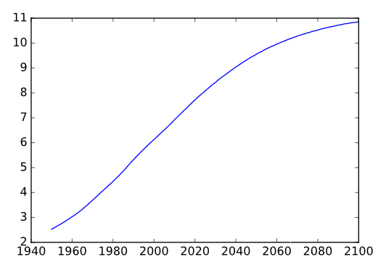
Solution
# Print the last item from year and pop
print(year[-1]) print(pop[-1])
# Import matplotlib.pyplot as plt
import matplotlib.pyplot as plt
# Make a line plot: year on the x-axis, pop on the y-axis
plt.plot(year,pop)
plt.show()

Slide 89
Line plot (3)
let's start working on the data that professor Hans Rosling used to build his beautiful bubble chart. It was collected in 2007.
Two lists are available for you:
life_exp which contains the life expectancy for each country and
gdp_cap, which contains the GDP per capita, for each country expressed in US Dollar.
GDP stands for Gross Domestic Product. It basically represents the size of the economy of a country. Divide this by the population and you get the GDP per capita.

Slide 90
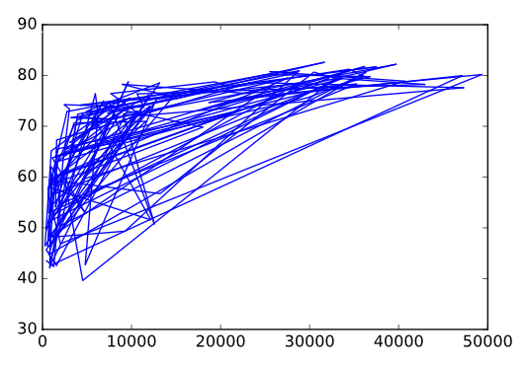
Solution
# Print the last item of gdp_cap and life_exp print(gdp_cap[-1]) print(life_exp[-1])
# Make a line plot, gdp_cap on the x-axis, life_exp on the y-axis
plt.plot(gdp_cap, life_exp)
# Display the plot
plt.show()

Slide 91
Scatter Plot (1)
When you have a time scale along the horizontal axis, the line plot is your friend.
But in many other cases, when you're trying to assess if there's a correlation between two variables, for example, the scatter plot is the better choice. Below is an example of how to build a scatter plot.
import matplotlib.pyplot as plt
plt.scatter(x,y)
plt.show()

Slide 92
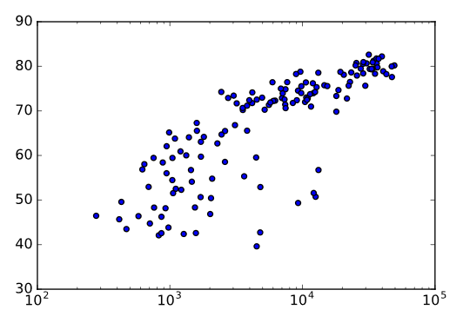
# Change the line plot below to a scatter plot
plt.scatter(gdp_cap, life_exp)
# Put the x-axis on a logarithmic scale
plt.xscale('log’)
# Show plot
plt.show()

Slide 93
Scatter plot (2)
In the previous exercise, you saw that that the higher GDP usually corresponds to a higher life expectancy. In other words, there is a positive correlation.
Do you think there's a relationship between population and life expectancy of a country?
The list life_exp from the previous exercise is already available. In addition, now also pop is available, listing the corresponding populations for the countries in 2007. The populations are in millions of people.

Slide 94
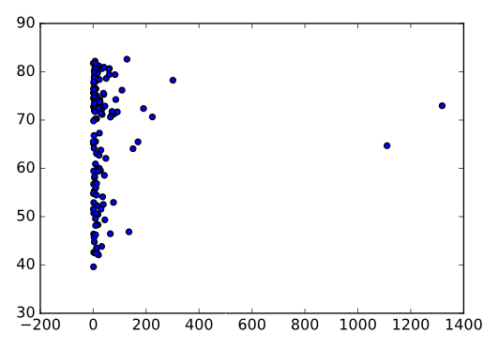
# Import package
import matplotlib.pyplot as plt
# Build Scatter plot
plt.scatter(pop, life_exp)
# Show plot
plt.show()

Slide 95
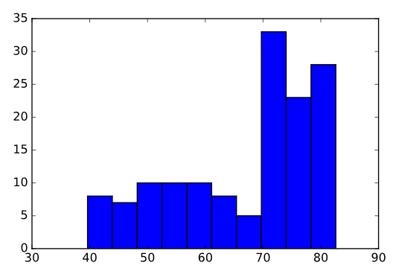
Histogram
# Create histogram of life_exp data
plt.hist(life_exp)
# Display histogram
plt.show()

Slide 96
Build a histogram (2): bins
In the previous exercise, you didn't specify the number of bins.
By default, Python sets the number of bins to 10 in that case.
The number of bins is pretty important.
Too little bins oversimplifies reality, which doesn't show you the details.
Too much bins overcomplicates reality and doesn't give the bigger picture.
To control the number of bins to divide your data in, you can set the bins argument.
The code in the script already includes plt.show() and plt.clf() calls; plt.show() displays a plot; plt.clf() cleans it up again so you can start afresh.

Slide 97
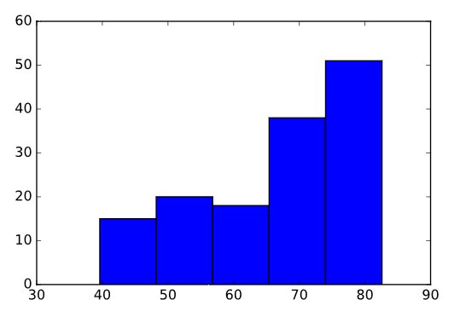
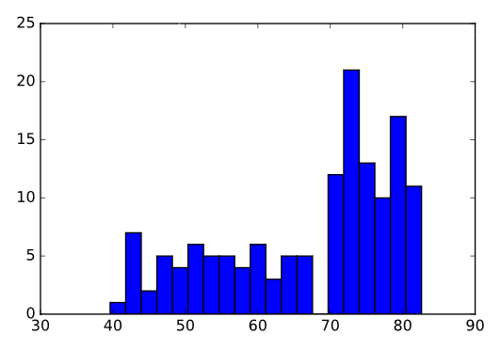
# Build histogram with 5 bins
plt.hist(life_exp, bins=5)
# Show and clean up plot
plt.show();plt.clf()
# Build histogram with 20 bins plt.hist(life_exp, bins=20)
# Show and clean up again
plt.show() plt.clf()

Slide 98
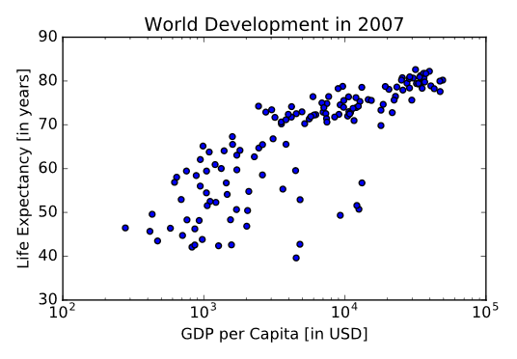
Plot customization: Label
# Basic scatter plot, log scale
plt.scatter(gdp_cap, life_exp)
plt.xscale('log’)
# Strings
xlab = 'GDP per Capita [in USD]’
ylab = 'Life Expectancy [in years]’
title = 'World Development in 2007’
# Add axis labels
plt.xlabel(xlab)
plt.ylabel(ylab)
# Add title
plt.title(title)
# After customizing, display the plot
plt.show()

Slide 99
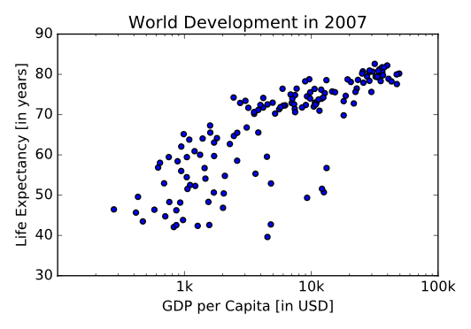
Adding ticks
# Scatter plot
plt.scatter(gdp_cap, life_exp)
# Previous customizations
plt.xscale('log’)
plt.xlabel('GDP per Capita [in USD]’)
plt.ylabel('Life Expectancy [in years]’)
plt.title('World Development in 2007’)
# Definition of tick_val and tick_lab
tick_val = [1000,10000,100000]
tick_lab = ['1k','10k','100k’]
# Adapt the ticks on the x-axis
plt.xticks(tick_val, tick_lab)
# After customizing, display the plot
plt.show()

Slide 100
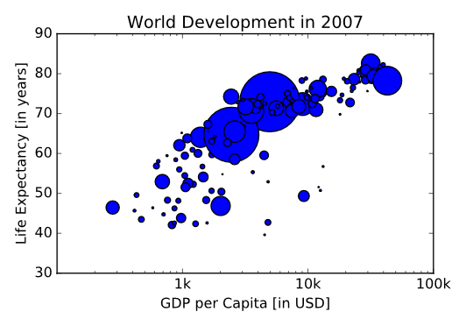
Changes size..
# Import numpy as np
import numpy as np
# Store pop as a numpy array: np_pop
np_pop=np.array(pop)
# Double np_pop
np_pop=np_pop*2
# Update: set s argument to np_pop
plt.scatter(gdp_cap, life_exp, s =np_pop)
# Previous customizations
plt.xscale('log’)
plt.xlabel('GDP per Capita [in USD]’)
plt.ylabel('Life Expectancy [in years]’)
plt.title('World Development in 2007’)
plt.xticks([1000, 10000, 100000],['1k', '10k', '100k’])
# Display the plot
plt.show()

Slide 101
colors
The next step is making the plot more colorful! To do this, a list col has been created for you.
It's a list with a color for each corresponding country, depending on the continent the country is part of. How did we make the list col you ask? The Gapminder data contains a list continent with the continent each country belongs to.
A dictionary is constructed that maps continents onto colors:
dict = { 'Asia':'red', 'Europe':'green', 'Africa':'blue', 'Americas':'yellow', 'Oceania':'black’ }
Nothing to worry about now; you will learn about dictionaries in the next chapter.

Slide 102
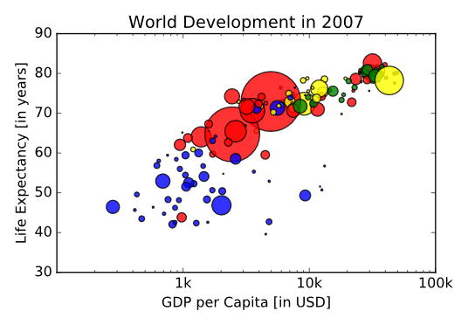
solution
# Specify c and alpha inside plt.scatter()
plt.scatter(x = gdp_cap, y = life_exp, s = np.array(pop) * 2, c=col, alpha=0.8)
# Previous customizations
plt.xscale('log’)
plt.xlabel('GDP per Capita [in USD]’)
plt.ylabel('Life Expectancy [in years]’)
plt.title('World Development in 2007’)
plt.xticks([1000,10000,100000], ['1k','10k','100k']) # Show the plot
plt.show()

Slide 103

Adding grid and text..
# Scatter plot
plt.scatter(x = gdp_cap, y = life_exp, s = np.array(pop) * 2, c = col, alpha = 0.8)
# Previous customizations
plt.xscale('log’)
plt.xlabel('GDP per Capita [in USD]’)
plt.ylabel('Life Expectancy [in years]’)
plt.title('World Development in 2007’)
plt.xticks([1000,10000,100000], ['1k','10k','100k’])
# Additional customizations
plt.text(1550, 71, 'India’)
plt.text(5700, 80, 'China’)
# Add grid() call
plt.grid(True)
# Show the plot
plt.show()

Slide 104
Control flow
To check if two Python values, or variables, are equal, you can use ==. To check for inequality, you need !=.
Examples, that all result in True.
>> 2 == (1 + 1)
>> "intermediate" != "python"
>> True != False
>> "Python" != "python"

Slide 105
If
It's time to take a closer look around in your house.
Two variables are defined in the sample code: room, a string that tells you which room of the house we're looking at, and area, the area of that room.
# Define variables
room = "kit"
area = 14.0
# if statement for room
if room == "kit" :
print("looking around in the kitchen.")
# if statement for area
if area > 15: print("big place!")

Slide 106
elif
# Define variables
room = "bed"
area = 14.0
# if-elif-else construct for room
if room == "kit" :
print("looking around in the kitchen.")
elif room == "bed":
print("looking around in the bedroom.")
else : print("looking around elsewhere.")
# if-elif-else construct for area
if area > 15 :
print("big place!")
elif area > 10:
print("medium size, nice!") else : print("pretty small.")

Slide 107
Pandas
In numpy only one type is possible
Pndas are High – level data manipulation tools
CSV to DataFrame (1) The DataFrame is one of Pandas' most important data structures.
It's basically a way to store tabular data, where you can label the rows and the columns.
Vehicle data in different countries.
Each observation corresponds to a country, and the columns give information about the number of vehicles per capita, whether people drive left or right, and so on.
This data is available in a CSV file, named cars.csv. It is available in your current working directory, so the path to the file is simply 'cars.csv'. To import CSV data into Python as a Pandas DataFrame, you can use read_csv().

Slide 108
Opening CSV files
# Import pandas as pd
import pandas as pd
# Import the cars.csv data: cars
cars=pd.read_csv('cars.csv’)
# Print out cars
print(cars)

Slide 109
CSV to DataFrame (2)
Remember index_col, an argument of read_csv() that you can use to specify which column in the CSV file should be used as a row label? Well, that's exactly what you need here!
# Import pandas as pd
import pandas as pd
# Fix import by including index_col
cars = pd.read_csv('cars.csv', index_col=0)
# Print out cars
print(cars)

Slide 110
Square Brackets
You can index and select Pandas DataFrames in many different ways.
The simplest, but not the most powerful way, is to use square brackets.
In the sample code on the right, the same cars data is imported from a CSV files as a Pandas DataFrame.
To select only the cars_per_cap column from cars, you can use:
cars['cars_per_cap’]
cars[['cars_per_cap’]]
The single bracket version gives a Pandas Series, the double bracket version gives a Pandas DataFrame.
# Import cars data
import pandas as pd
cars = pd.read_csv('cars.csv', index_col = 0)
# Print out country column as Pandas Series
print(cars['country’])
# Print out country column as Pandas DataFrame
print(cars[['country']])

Slide 111
loc
With loc you can do practically any data selection operation on DataFrames you can think of.
loc is label-based,
which means that you have to specify rows and columns based on their row and column labels.
Try out the following commands in the IPython Shell to experiment with loc to select observations:
cars.loc['RU’]
cars.loc[['RU’]]
cars.loc[['RU', 'AUS']]

Slide 112
Using dataframe.loc[‘feature’]
Use loc to select the observation corresponding to Japan as a Series. The label of this row is JAP. Make sure to print the resulting Series.
Use loc to select the observations for Australia and Egypt as a DataFrame. You can find out about the labels of these rows by inspecting cars in the IPython Shell. Make sure to print the resulting DataFrame.
# Import cars data
import pandas as pd
cars = pd.read_csv('cars.csv', index_col = 0)
# Print out observation for Japan
print(cars.loc['JAP’])
# Print out observations for Australia and Egypt
print(cars.loc[['AUS', 'EG']])

Slide 113
loc
loc also allows you to select both rows and columns from a DataFrame.
cars.loc['IN', 'cars_per_cap’]
cars.loc[['IN', 'RU'], 'cars_per_cap’]
cars.loc[['IN', 'RU'], ['cars_per_cap', 'country']]
Print out the drives_right value of the row corresponding to Morocco (its row label is MOR)
Print out a sub-DataFrame, containing the observations for Russia and Morocco and the columns country and drives_right.

Slide 114
# Import cars data
import pandas as pd
cars = pd.read_csv('cars.csv', index_col = 0)
# Print out drives_right value of Morocco
print(cars.loc['MOR', 'drives_right’])
# Print sub-DataFrame
print(cars.loc[['RU','MOR'],['country', 'drives_right']])

Slide 115
Using dataframe.describe()
Print the .dtypes of your data so that you know what each column contains.
Output basic summary statistics using a single pandas function. With the same function from before, summary statistics for all columns that aren't of type object.
# Print .dtypes
print(recent_grads.dtypes)
# Output summary statistics print(recent_grads.describe())
# Exclude data of type object
print(recent_grads.describe(exclude=['object']))

Slide 116
Replacing missing values
Some of the columns in your dataset have type object.
There are also some missing values in the dataset that aren't explicitly coded. You'll take care of these data quality issues right now.
Look at the dtypes of the columns in columns to make sure that the data is numeric.
It looks like a string is being used to encode missing values. Use the .unique() method to figure out what the string is.
Search for missing values in the median, p25th, and p75th columns.
Replace the found missing values with a NaN value, using numpy's np.nan.

Slide 117
# Names of the columns we're searching for missing values
columns = ['median', 'p25th', 'p75th’]
# Take a look at the dtypes
print(recent_grads[columns].dtypes)
# Find how missing values are represented print(recent_grads["median"].unique())
# Replace missing values with NaN
for column in columns: recent_grads.loc[recent_grads[column] == 'UN', column] = np.nan

Slide 118
Selecting columns
Select a Column
Select the sharewomen column from recent_grads and assign this to a variable named sw_col.
Output the first 5 rows of sw_col.
# Select sharewomen column
sw_col = recent_grads['sharewomen’]
# Output first five rows
print(sw_col[0:5])

Slide 119
Column Maximum Value
Import numpy as np. Using a numpy built-in function, find the maximum value of the sharewomen column and assign this value to the variable max_sw. Print the value of max_sw
# Import numpy
import numpy as np
# Use max to output maximum values
max_sw = sw_col.max()
# Print column max
print(max_sw)

Slide 120
Selecting a row
While you know what the maximum percentage of women in a department is, which department is this? You'll output this information by filtering the dataset with pandas.
The variables sw_col and max_sw are still in your workspace.
Output the row of data for the department that has the largest percentage of women.
# Output the row containing the maximum percentage of women
print(recent_grads[sw_col == max_sw])

Slide 121
Converting a DataFrame to Numpy Array
Since numpy is such a powerful Python module, this exercise asks you to convert a pandas DataFrame to a numpy array to then utilize a statistics metric available through numpy in the next exercise.
Select the columns unemployed and low_wage_jobs from recent_grads, then convert them to a numpy array. Save this as recent_grads_np.
Print the type of recent_grads_np to see that it is a numpy array.

Slide 122
Solution
# Convert to numpy array
recent_grads_np = np.array(recent_grads[['unemployed','low_wage_jobs']])
# Print the type of recent_grads_np
print(type(recent_grads_np))

Slide 123
Correlation Coefficient
You have some suspicion that there's a relationship between the low_wage_jobs and unemployment_rate columns, so you decide to use numpy to calculate the correlation coefficient.
Calculate the correlation matrix of the numpy array recent_grads_np.
# Calculate correlation matrix
print(np.corrcoef(recent_grads_np[:,0],recent_grads_np[:,1]))

Slide 124
Creating Columns I
If you look at the dataset, you'll notice that while there's a column which shows the percentage of women in each department, there is no column which shows the percentage of men.
Create a new column named sharemen, that contains the percentage of men for a given department.
# Add sharemen column
recent_grads['sharemen'] = recent_grads['men'] / (recent_grads['men']+recent_grads['women'])

Slide 125
Select Row with Highest Value
Remember how you found the row of data with the highest percentage of women? Now you'll find the row that corresponds to the department with the highest rate of men.
The module numpy has been imported under the alias np for you.
Using numpy, find the maximum value for the percentage of men and call this variable max_men.
Select the row that has the percentage of men which corresponds to max_men.
# Find the maximum percentage value of men
max_men = np.max(recent_grads['sharemen’])
# Output the row with the highest percentage of men
print(recent_grads[recent_grads['sharemen'] == max_men])

Slide 126
Creating columns II
Eventually you want to figure out which departments are most balanced between men and women. To accomplish this, you'll add a new column that reports the difference in percentages between men and women.
Add a column named gender_diff that reports how much higher the rate of women is than the rate of men.
# Add gender_diff column
recent_grads['gender_diff']=recent_grads['sharewomen']recent_grads['sharemen']

Slide 127
Updating columns
Your data for the gender_diff column currently consists of negative and positive values, which depend on which group of people (women or men) have a higher percentage. You want to find the five departments with the most balanced gender ratios, but first you decide to make your life easier by replacing the values in the gender_diff column with their respective absolute values.
Use numpy and pandas to convert each value in the gender_diff column to its absolute value.
Output the five departments with the most balanced gender ratios

Slide 128
Solution
# Make all gender difference values positive
recent_grads['gender_diff'] = np.abs(recent_grads['gender_diff’])
# Find the 5 rows with lowest gender rate difference
print(recent_grads.nsmallest(5, 'gender_diff'))

Slide 129
Filtering rows
Finally you can filter out for departments which fail the benchmark of a difference of more than 0.30.
Since all the values are now positive, you can do this with a simple boolean operator.
You want to find the rows containing departments that are skewed heavily towards men.
Using work you've already done, you'll create a new DataFrame that contains this information.
The DataFrame recent_grads still has the columns sharemen and gender_diff that you created in previous exercises.

Slide 130
Filtering rows
Create diff_30, a boolean Series that is True when the corresponding value of gender_diff is greater than 0.30 and False otherwise.
Make another boolean Series called more_men that's true when the corresponding row in recent_grads has more men than women.
Combine your two Series to make one that you can use to select rows that have both more men than women and a value of gender_diff greater than 0.30. Save the result as more_men_and_diff_30.
Use this new boolean Series to create the DataFrame fewer_women that contains only the rows you're interested in.

Slide 131
Solution
# Rows where gender rate difference is greater than .30
diff_30 = recent_grads['gender_diff'] > .30
# Rows with more men
more_men = recent_grads['sharemen’] > recent_grads['sharewomen’]
# Combine more_men and diff_30
more_men_and_diff_30 = np.logical_and(diff_30, more_men)
# Find rows with more men and and gender rate difference greater than .30
fewer_women = recent_grads[more_men_and_diff_30]

Slide 132
Grouping with Counts
Calls to .groupby() have the following three components:
the column you want to group,
the column you want to aggregate,
and the statistic you want to aggregate by.
For example, in our dataset, if we wanted to see the percentage of women ('sharewomen') per 'major_category', we could leverage a .groupby like so:
recent_grads.groupby('major_category')['sharewomen'].mean().
Here, we are grouping by 'major_category', and aggregating 'sharewomen' by the mean. Give it a try in the IPython Shell if you're curious to see the result!

Slide 133
Grouping with counts
Using the .groupby() method, group the recent_grads DataFrame by 'major_category' and then count the number of departments per category using .count().
Solution:
print(recent_grads.groupby(['major_category']).major_category.count())
# Group departments that have less women by category and count
print(fewer_women.groupby(['major_category']).major_category.count())

Slide 134
Grouping One Column with Means
Similar to the exercise you just completed, you can group rows to output the means of different groups within a column.
The column gender_diff is still available in the recent_grads DataFrame.
Write code that outputs the average gender percentage difference by major category.
print(recent_grads.groupby('major_category')['gender_diff'].mean())

Slide 135
Grouping Two Columns with Means
Write a query that outputs the mean number of 'low_wage_jobs' and average 'unemployment_rate' grouped by 'major_category’.
# Find average number of low wage jobs and unemployment rate of each major category
dept_stats=recent_grads.groupby('major_category')['low_wage_jobs','unemployment_rate'].mean()

Slide 136
Plotting Scatterplots
Now that you've calculated the correlation coefficient between the low_wage_jobs and unemployment_rate columns,
you want to create a visualization to effectively display this relationship.
You'll use matplotlib to create a scatterplot of these two columns.
The DataFrame dept_stats is available in your workspace again, and the columns low_wage_jobs and unemployment_rate have been extracted into variables of the same name.

Slide 137
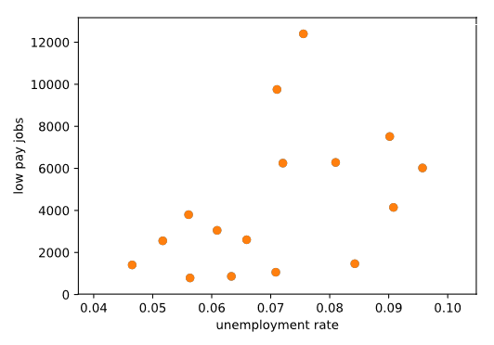
# Import matplotlib import matplotlib.pyplot as plt # Create scatter plot plt.scatter(dept_stats['unemployment_rate'], dept_stats['low_wage_jobs']) # Label x axis plt.xlabel('unemployment rate') # Label y axis plt.ylabel('low pay jobs') # Display the graph plt.show()

Slide 138
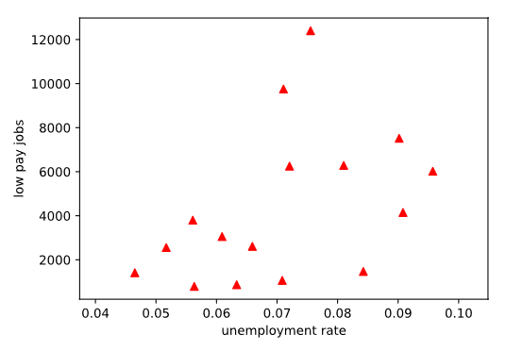
Modifying Plot Colors
The default settings for matplotlib may not be what you hope to present to others, so you decide to customize your plot for low wages versus unemployment rate. Use the pandas DataFrame dept_stats again.
# Plot the red and triangle shaped scatter plot
plt.scatter(unemployment_rate, low_wage_jobs, color = "r", marker = "^")
# Display the visualization
plt.show()

Slide 139
Plotting with pandas
In Python, there are several different ways to create visualizations. In fact, pandas has its own visualization capabilities, all of which are built on top of matplotlib! For example, you could have created the histogram from the previous exercise using recent_grads.sharewomen(kind="hist") instead of plt.hist(recent_grads.sharewomen).
Which approach you prefer comes down to personal preference - when working with DataFrames, it is advantageous to use pandas' plotting capabilities because the code tends to be less verbose.
Here, you will practice creating the plots from the previous exercises using pandas instead of matplotlib. All pandas plots are created using the .plot() method on a DataFrame. Inside .plot(), you can specify which plot you want to create using the kind parameter. For example, kind= 'hist' would create a histogram, kind='scatter' would create a scatter plot, and so on.

Slide 140
Plot using pandas
Use the .plot() method with kind='scatter' on the dept_stats DataFrame to create a scatter plot with 'unemployment_rate' on the x-axis and 'low_wage_jobs' on the y-axis.
# Import matplotlib and pandas import matplotlib.pyplot as plt import pandas as pd
# Create scatter plot dept_stats.plot(kind='scatter', x='unemployment_rate', y='low_wage_jobs') plt.show()

Slide 141
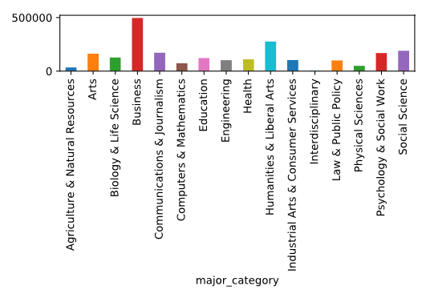
Plotting One Bar Graphs
First, create a DataFrame to plot. Use recent_grads to make a DataFrame that reports each major category and the number of college graduates with a job that doesn't require a degree. Assign this to a variable named df.
Plot this data as a bar chart using the .plot() method. Here, kind should be "bar".
# DataFrame of non-college job sums df = recent_grads.groupby(['major_category']).non_college_jobs.sum() # Plot bar chart df.plot(kind="bar") # Show graph plt.show()

Slide 142
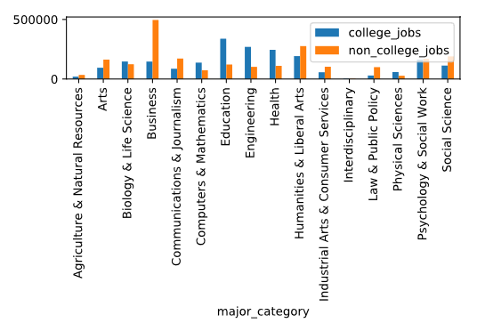
Plotting Two Bar Graphs
Use pandas to create a DataFrame that reports the number of graduates working at jobs that do require college degrees ('college_jobs'), and do not require college degrees ('non_college_jobs'). Assign this to a variable named df1.
Create a plot that reports this data with matplotlib.
Display the plot you've created!
# DataFrame of college and non-college job sums
df1 = recent_grads.groupby(['major_category'])['college_jobs','non_college_jobs'].sum()
# DataFrame of college and non-college job sums df1 = recent_grads.groupby(['major_category'])['college_jobs','non_college_jobs'].sum() # Plot bar chart df1.plot(kind="bar") # Show graph plt.show()

Slide 143
Dropping Missing Values
Now that you've replaced the UN values with NaN values, you realize it's better that you just delete these rows completely. In this exercise, you'll do just that. To confirm you filtered out the rows, you’ll then check the size of the DataFrame to confirm the size is smaller.
With a single line of code, drop all the rows that have a missing value.
Print the size of the manipulated DataFrame.
# Print the size of the DataFrame print(recent_grads.size)
# Drop all rows with a missing value recent_grads.dropna(axis = 0, inplace = True)
# Print the size of the DataFrame print(recent_grads.size)

Slide 144
Plotting Quantiles of Salary, Part 1
# Convert to numeric and divide by 1000
recent_grads['median’]=pd.to_numeric(recent_grads['median']) / 1000
recent_grads['p25th']=pd.to_numeric(recent_grads['p25th']) / 1000
recent_grads['p75th']=pd.to_numeric(recent_grads['p75th']) / 1000
# Select averages by major category
columns = ['median', 'p25th', 'p75th’]
sal_quantiles=recent_grads.groupby(['major_category'])[columns].mean()

Slide 145
Plotting Quantiles of Salary, Part 2
Plot the DataFrame.
Clean up the x-axis labels with the function plt.xticks(). Set the first argument equal to np.arange(len(sal_quantiles.index)), the second argument equal to sal_quantiles.index, and the keyword argument rotation = 'vertical'.
Now call the .plot() method with the argument subplots=True to plot the columns on separate axes. Show this plot as well.

Slide 146
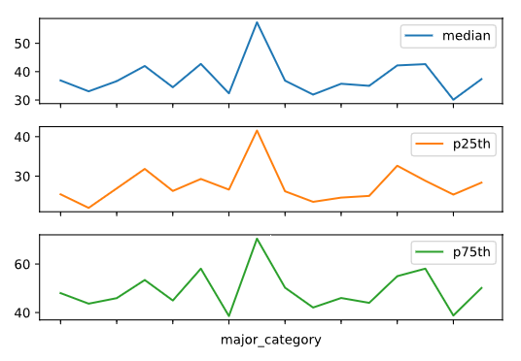
# Plot the data
sal_quantiles.plot()
# Set xticks
plt.xticks(np.arange(len(sal_quantiles.index)), sal_quantiles.index, rotation='vertical’)
# Show the plot plt.show()
# Plot with subplots sal_quantiles.plot(subplots=True) plt.show()

Slide 147

Please contact
Foundation for Innovation and Collaborative
Education
mentor@fice.in
www.fice.in
Please contact
Foundation for Innovation and Collaborative
Education
info@fice.in
mentor@fice.in
Notes:
Here are the lessons we are going to learn today.

